Slide 1
Natural Language Processing DTS305TC
Huakang Li
Huakang.li@xjtlu.edu.cn
School of AI and Advanced Computing
Notes:
English Title: Uppercase, Calibri size 60, XJTLU Navy
English Subtitle: Uppercase, Calibri size 36, XJTLU Navy

Slide 2
Lab 7 Document clustering
week 4 day 1
https://spotintelligence.com/2023/10/23/document-classification-python/

Slide 3
Overview
Clustering Knowledge
Hierarchical Clustering
K-means
LDA

Slide 4
What are the types of clustering?
Centroid-based clustering: This type of clustering uses the mean or median of a cluster’s points as the cluster’s centre or centroid. K-means is the most popular centroid-based clustering algorithm.
Hierarchical clustering: This type of clustering builds a hierarchy of clusters, where each cluster is a subset of the next higher-level cluster. There are two main types of hierarchical clustering: agglomerative and divisive.
Density-based clustering: This type of clustering groups together points that are close to each other in the feature space. DBSCAN is the most popular density-based clustering algorithm.
Distribution-based clustering: This type of clustering models the data as a mixture of probability distributions. The Gaussian Mixture Model (GMM) is the most popular distribution-based clustering algorithm.
Spectral clustering: This type of clustering uses the eigenvectors of a similarity matrix to cluster the data.
Neural network-based clustering: This type of clustering uses neural networks to learn the cluster structure of the data. Examples of this method are autoencoders and deep embedding clustering.

Slide 5
Applications of text clustering
Classifying text: Clustering can be used as a preprocessing step to put text documents into categories that have already been set up.
Information retrieval: Clustering can be used to group similar documents together, making it easier to find relevant information.
Text summarization: Clustering can be used to find the most representative or essential documents in a dataset, which can then be used to summarise the dataset’s content.
Opinion mining and sentiment analysis: Clustering can group text documents expressing similar opinions or feelings.
Topic modelling: Clustering can be used to find hidden topics in text documents, which can then determine how the data is organised.
Language model improvement: clustering can be used to group text documents with similar topics or writing styles, which can then be used to improve language models.
Marketing: Clustering can be used to group customer feedback, reviews, and survey responses to understand customer preferences, opinions, and feedback.
Social Media Analysis: Clustering can be used to group social media posts, comments, and tweets, to understand the overall sentiment and opinions on a certain topic.

Slide 6
Challenges of text clustering
High dimensionality: Text data is often represented as a high-dimensional sparse matrix, making it hard to use traditional clustering algorithms.
Noise and outliers: Text data can have noise like misspellings, typos, and irrelevant information, making it hard to find patterns that mean something.
Categorical data: Text data is often categorical, which means it doesn’t have a natural sense of distance or similarity.
Handling synonyms and polysemy: Words in text data often have more than one meaning, making it hard to figure out the real meaning.
Handling sparse data: Text data is often sparse, meaning many words don’t appear in most documents. This makes it hard to find patterns in the data that mean something.
Handling large datasets: Clustering large datasets can be computationally expensive and require a large amount of memory.
Handling new words: Clustering algorithms are trained on a fixed dataset, so they may not be able to handle new words in the training dataset.
Scalability: Clustering algorithms should scale well with increasing data size; otherwise, they can become impractical to use with large datasets.
Evaluation: Clustering results are hard to evaluate since there is no single correct answer for clustering and the evaluation metric depends on the application and the dataset.

Slide 7
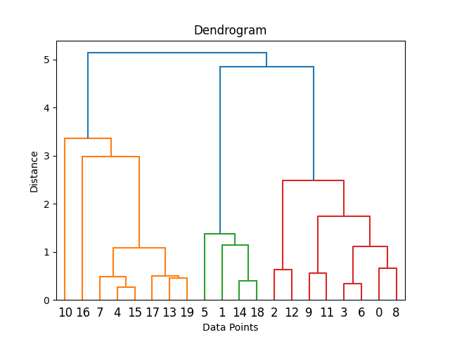
Hierarchical Clustering
Agglomerative clustering starts with each data point as its own cluster and then iteratively merges the closest clusters into larger clusters until only one cluster remains. The steps involved in agglomerative clustering are as follows:
Begin with each data point as a separate cluster.
Find the two closest clusters and merge them into a single cluster.
Repeat step 2 until all data points are in one cluster, forming a hierarchy of clusters.

Slide 8
How Does Hierarchical Clustering Work?
1. Initialization:
Begin with each data point as a separate cluster. In other words, if you have ‘n’ data points, you start with ‘n’ clusters, each containing one data point.
2. Distance Calculation:
Calculate the pairwise distances or similarities between all clusters. This step requires a distance metric or similarity measure, such as Euclidean distance, Manhattan distance, or cosine similarity, depending on the nature of your data and problem.
3. Merging Clusters (Agglomerative Clustering):
Find the two closest clusters based on the distance/similarity metric. These clusters are merged into a single cluster.
The choice of which clusters to merge can be determined by different linkage criteria, such as:
Single Linkage: Merge clusters based on the closest pair of data points between the clusters.
Complete Linkage: Merge clusters based on the farthest pair of data points between the clusters.
Average Linkage: Merge clusters based on the average distance between all pairs of data points between the clusters.
Centroid Linkage: Merge clusters based on the distance between the clusters’ centroids (mean points).

Slide 9
How Does Hierarchical Clustering Work?
4. Update the Distance Matrix:
Recalculate the distances or similarities between the newly formed and the remaining clusters.
This step reduces the number of clusters by one.
5. Repeat Steps 3 and 4:
Continue merging the closest clusters and updating the distance matrix until only one cluster remains. This process forms a hierarchy of clusters.
6. Creating a Dendrogram:
As clusters are merged, you can represent the hierarchical structure using a dendrogram. A dendrogram is a tree-like diagram visually showing clusters’ merging processes and relationships.
7. Cutting the Dendrogram:
You can cut the dendrogram at a certain level to obtain a specific number of clusters. The height at which you cut the dendrogram determines the number of clusters you get. Choosing the right level often involves domain knowledge or methods like the elbow method or silhouette analysis.
8. Cluster Assignment:
Once you’ve determined the desired number of clusters, you can assign each data point to its corresponding cluster based on the hierarchical structure you’ve created.

Slide 10
Advantages
1. Hierarchy of Clusters:
Interpretability: Hierarchical clustering visually represents the data’s structure as a dendrogram. This hierarchy allows users to explore and interpret the relationships between clusters at different levels of granularity.
2. No Need for Predefined Clusters:
Flexibility: Unlike other clustering methods requiring you to specify the number of clusters in advance, hierarchical clustering does not. It can reveal the natural grouping of data points without prior assumptions about the number of clusters.
3. Handling Various Cluster Shapes:
Robustness: Hierarchical clustering can handle clusters of different shapes and sizes, including irregularly shaped clusters or clusters with varying densities.
4. Agglomerative and Divisive Approaches:
Versatility: Hierarchical clustering offers agglomerative and divisive approaches, allowing users to choose the best method for their data and objectives.
5. Outlier Detection:
Anomaly Identification: It can be used for outlier detection by isolating data points that do not fit well into any cluster.

Slide 11
Limitations
1. Computational Complexity:
Scalability: Hierarchical clustering can be computationally expensive, especially for large datasets, because it requires the calculation of distances between all data points and clusters at each step.
2. Sensitivity to Noise:
Noise Sensitivity: Hierarchical clustering is sensitive to noise and outliers, which can lead to suboptimal cluster assignments if not correctly addressed.
3. Lack of Reversibility:
Irreversibility: Once clusters are merged in agglomerative hierarchical clustering, they cannot be split apart in the same analysis. Divisive hierarchical clustering, on the other hand, allows splitting clusters but is less commonly used.
4. Subjectivity in Dendrogram Cutting:
Dendrogram Cutting: Determining the optimal number of clusters by cutting the dendrogram can be subjective and may depend on domain knowledge or arbitrary thresholds. It can result in different clusterings based on how the dendrogram is cut.
5. Memory Usage:
Large Memory Footprint: When working with large datasets, hierarchical clustering can consume significant memory due to the storage of distance matrices and dendrograms.
6. Lack of Global Optimality:
Lack of Global Optimum: The hierarchical merging process is a greedy algorithm that may not always lead to the globally optimal clustering solution. It depends on the choice of distance metric, linkage criteria, and starting conditions.

Slide 12
import numpy as np
import scipy.cluster.hierarchy as sch
import matplotlib.pyplot as plt
np.random.seed(0)
data = np.random.randn(20, 2)
print(data)
from scipy.spatial import distance
distance_matrix = distance.pdist(data, metric='euclidean')
linkage_matrix = sch.linkage(distance_matrix, method='ward')
dendrogram = sch.dendrogram(linkage_matrix)
plt.xlabel('Data Points')
plt.ylabel('Distance')
plt.title('Dendrogram')
plt.show()
from scipy.cluster.hierarchy import fcluster
# Set the threshold for cutting the dendrogram
threshold = 2
# Assign each data point to a cluster based on the threshold
clusters = fcluster(linkage_matrix, threshold, criterion='distance')
plt.scatter(data[:, 0], data[:, 1], c=clusters, cmap='viridis')
plt.xlabel('Feature 1')
plt.ylabel('Feature 2')
plt.title('Hierarchical Clustering Results')
plt.show()

Slide 13
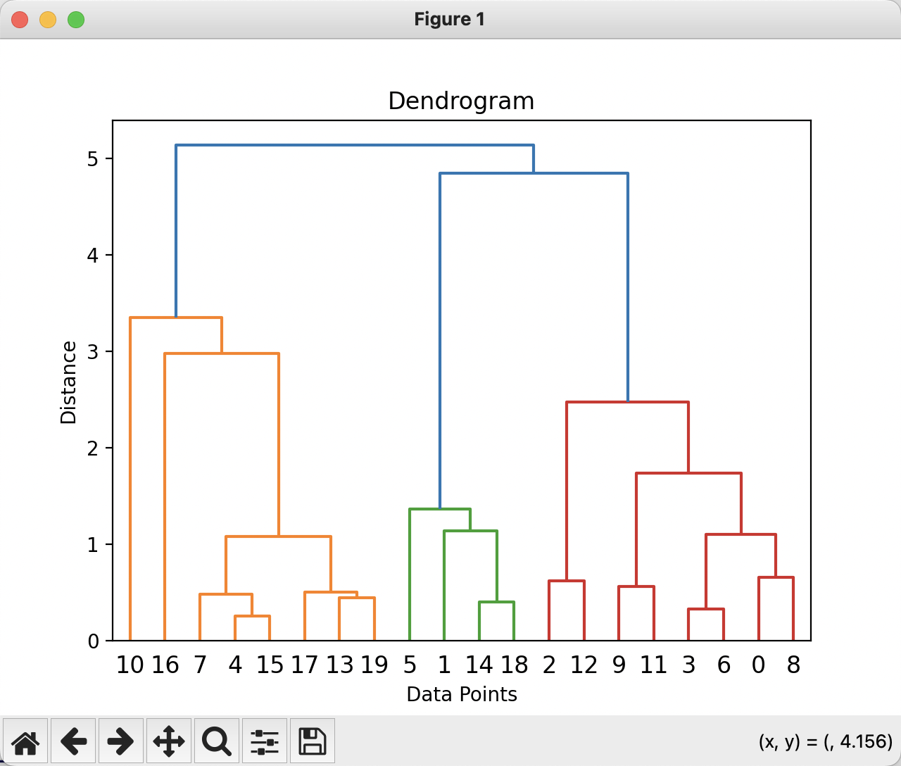
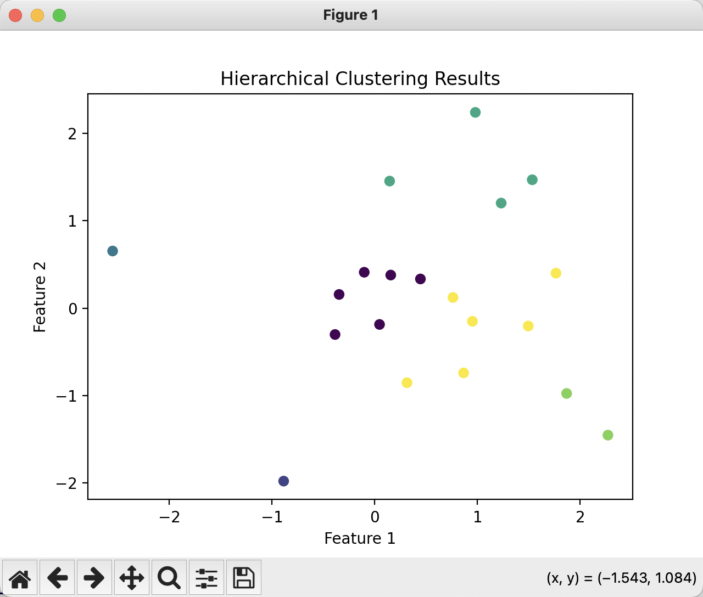
[ 1.76405235 0.40015721]
[ 0.97873798 2.2408932 ]
[ 1.86755799 -0.97727788]
[ 0.95008842 -0.15135721]
[-0.10321885 0.4105985 ]
[ 0.14404357 1.45427351]
[ 0.76103773 0.12167502]
[ 0.44386323 0.33367433]
[ 1.49407907 -0.20515826]
[ 0.3130677 -0.85409574]
[-2.55298982 0.6536186 ]
[ 0.8644362 -0.74216502]
[ 2.26975462 -1.45436567]
[ 0.04575852 -0.18718385]
[ 1.53277921 1.46935877]
[ 0.15494743 0.37816252]
[-0.88778575 -1.98079647]
[-0.34791215 0.15634897]
[ 1.23029068 1.20237985]
[-0.38732682 -0.30230275]

Slide 14
import pandas as pd
from sklearn.feature_extraction.text import TfidfVectorizer
from sklearn.cluster import AgglomerativeClustering
from sklearn.metrics import classification_report, confusion_matrix
from sklearn.preprocessing import LabelEncoder
import matplotlib.pyplot as plt
from scipy.cluster.hierarchy import dendrogram, linkage
from sklearn.metrics import silhouette_score, calinski_harabasz_score, davies_bouldin_score
file_path = 'business_data.csv'
df = pd.read_csv(file_path)
vectorizer = TfidfVectorizer(stop_words='english')
X = vectorizer.fit_transform(df['content'])
agg_clustering = AgglomerativeClustering(n_clusters=2, linkage='ward', metric='euclidean')
df['cluster'] = agg_clustering.fit_predict(X.toarray())
le = LabelEncoder()
df['category_encoded'] = le.fit_transform(df['category'])
report = classification_report(df['category_encoded'], df['cluster'], output_dict=True)
accuracy = report['accuracy']
recall = report['macro avg']['recall']
f1 = report['macro avg']['f1-score']
print(f"Accuracy: {accuracy:.4f}")
print(f"Recall: {recall:.4f}")
print(f"F1-Score: {f1:.4f}")
conf_matrix = confusion_matrix(df['category_encoded'], df['cluster'])
print("Confusion Matrix:")
print(conf_matrix)
silhouette_avg = silhouette_score(X.toarray(), df['cluster'])
calinski_harabasz = calinski_harabasz_score(X.toarray(), df['cluster'])
davies_bouldin = davies_bouldin_score(X.toarray(), df['cluster'])
print(f"Silhouette Coefficient: {silhouette_avg:.4f}")
print(f"Calinski-Harabasz Index: {calinski_harabasz:.4f}")
print(f"Davies-Bouldin Index: {davies_bouldin:.4f}")
linked = linkage(X.toarray(), method='ward')
plt.figure(figsize=(10, 7))
dendrogram(linked, orientation='top', distance_sort='descending', show_leaf_counts=True)
plt.title('Hierarchical Clustering Dendrogram')
plt.show()

Slide 15
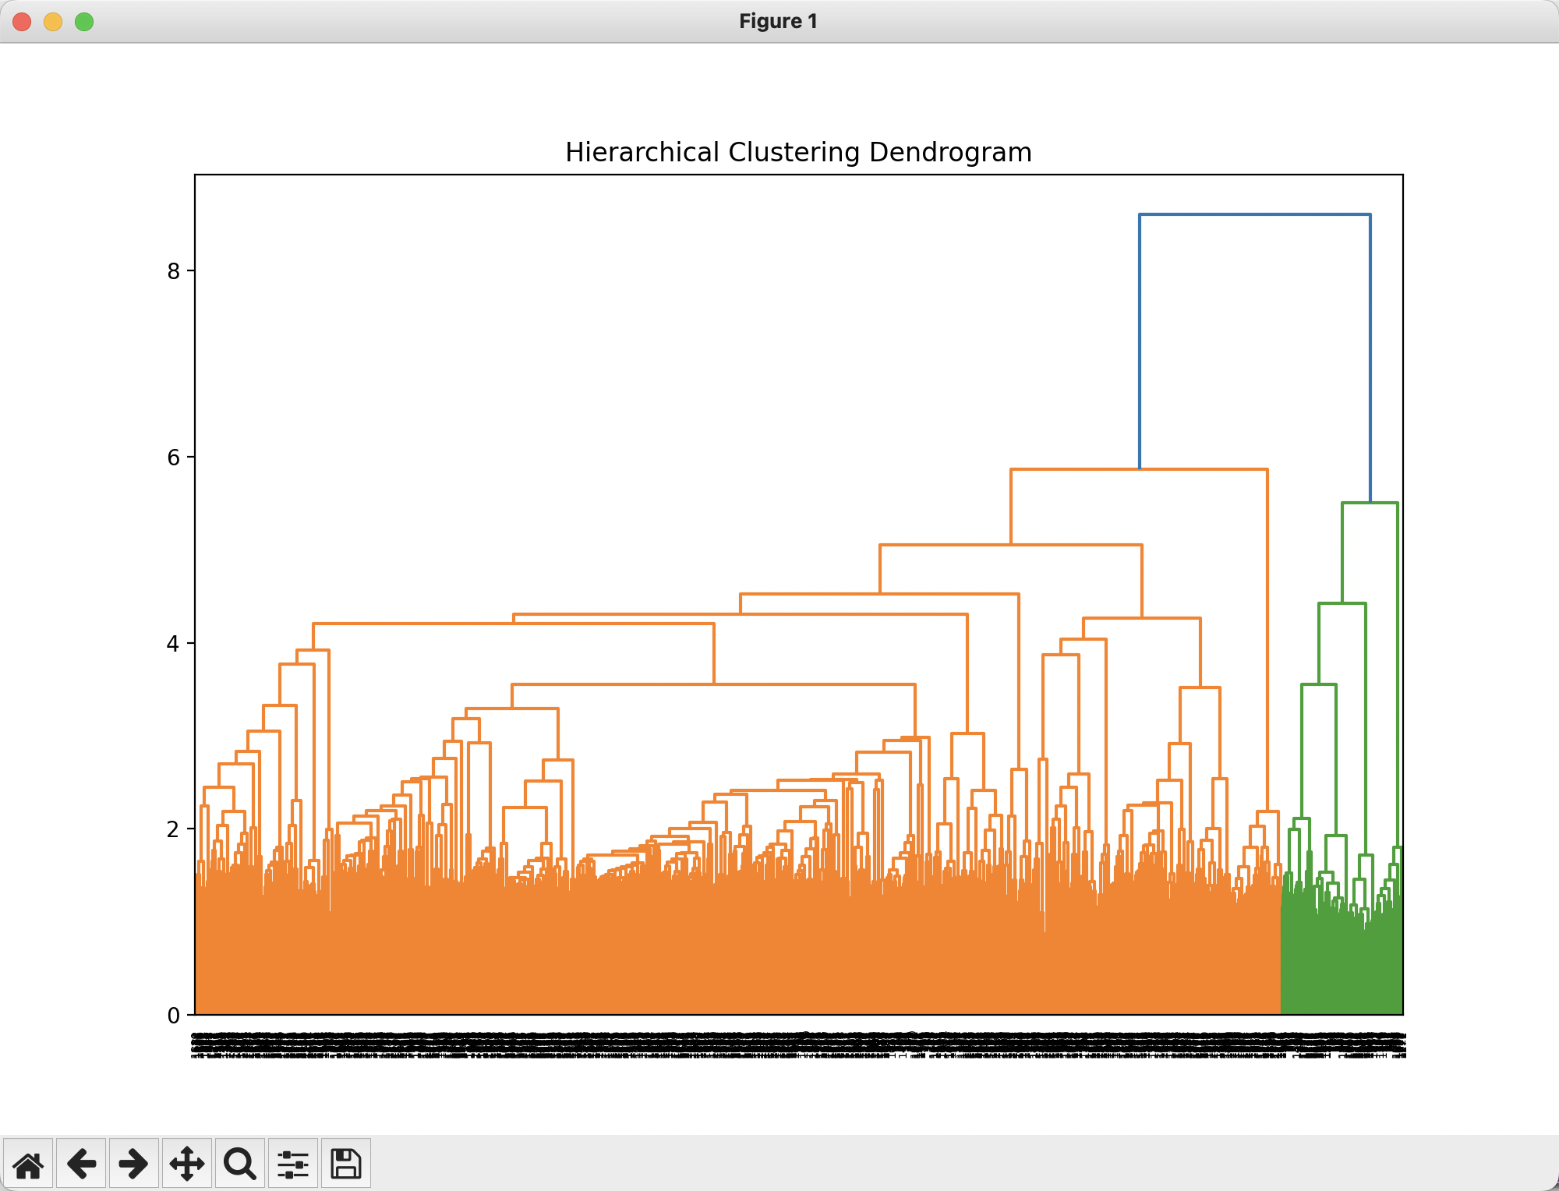
Accuracy: 0.4805
Recall: 0.4809
F1-Score: 0.3818
Confusion Matrix:
[[880 119]
[920 81]]
Silhouette Coefficient: 0.0088
Calinski-Harabasz Index: 39.2041
Davies-Bouldin Index: 4.0673
model = tf.keras.Model(inputs, outputs)
model.compile(optimizer='adam', loss='sparse_categorical_crossentropy', metrics=['accuracy'])
precision recall f1-score support
business 0.80 0.63 0.71 199
tradee 0.70 0.84 0.76 201
accuracy 0.74 400
macro avg 0.75 0.74 0.73 400
weighted avg 0.75 0.74 0.73 400
Clustering algorithm: performs better in vector space representation of sample contents
Classification algorithm: performs better in fitting sample labels

Slide 16
The KMeans algorithm explained step-by-step
1. Initialization:
Choose the number of clusters, K.
Initialize K cluster centroids. This can be done by randomly selecting K data points from the dataset.
2. Assignment:
For each data point in the dataset, calculate the distance (usually Euclidean distance) to each K centroid.
Assign the data point to the cluster corresponding to the nearest centroid.
3. Update Centroids:
After all data points are assigned to clusters, calculate the mean of all data points in each cluster. This mean becomes the new centroid for that cluster.
4. Re-Assignment:
Repeat the assignment step using the updated centroids. Data points are reassigned to clusters based on the new centroids.
5. Iteration:
Repeat the Update Centroids, and Re-Assignment steps iteratively until a stopping criterion is met. This criterion can be a maximum number of iterations or a slight change in centroids between iterations.

Slide 17
The KMeans algorithm explained step-by-step
6. Convergence:
The algorithm converges when the centroids no longer change significantly between iterations, and the assignments become stable.
7. Final Result:
Once the algorithm converges, the data points are effectively partitioned into K clusters based on their proximity to the centroids.
8. Choosing Optimal K:
Determining the optimal number of clusters, K can be a challenge. One common approach is the “elbow method,” where you plot the sum of squared distances (inertia) for different values of K and look for an “elbow point” where the rate of decrease in inertia slows down.
9. Centroid Initialization Strategies:
While random initialization is common, it can lead to suboptimal solutions. KMeans++ is a popular initialization technique that distributes initial centroids more evenly across the data points, improving convergence speed and quality of results.
10. Handling Convergence to Local Optima:
To mitigate convergence to local optima, you can run the KMeans algorithm multiple times with different initializations and select the best result based on some criterion, such as the lowest sum of squared distances.

Slide 18
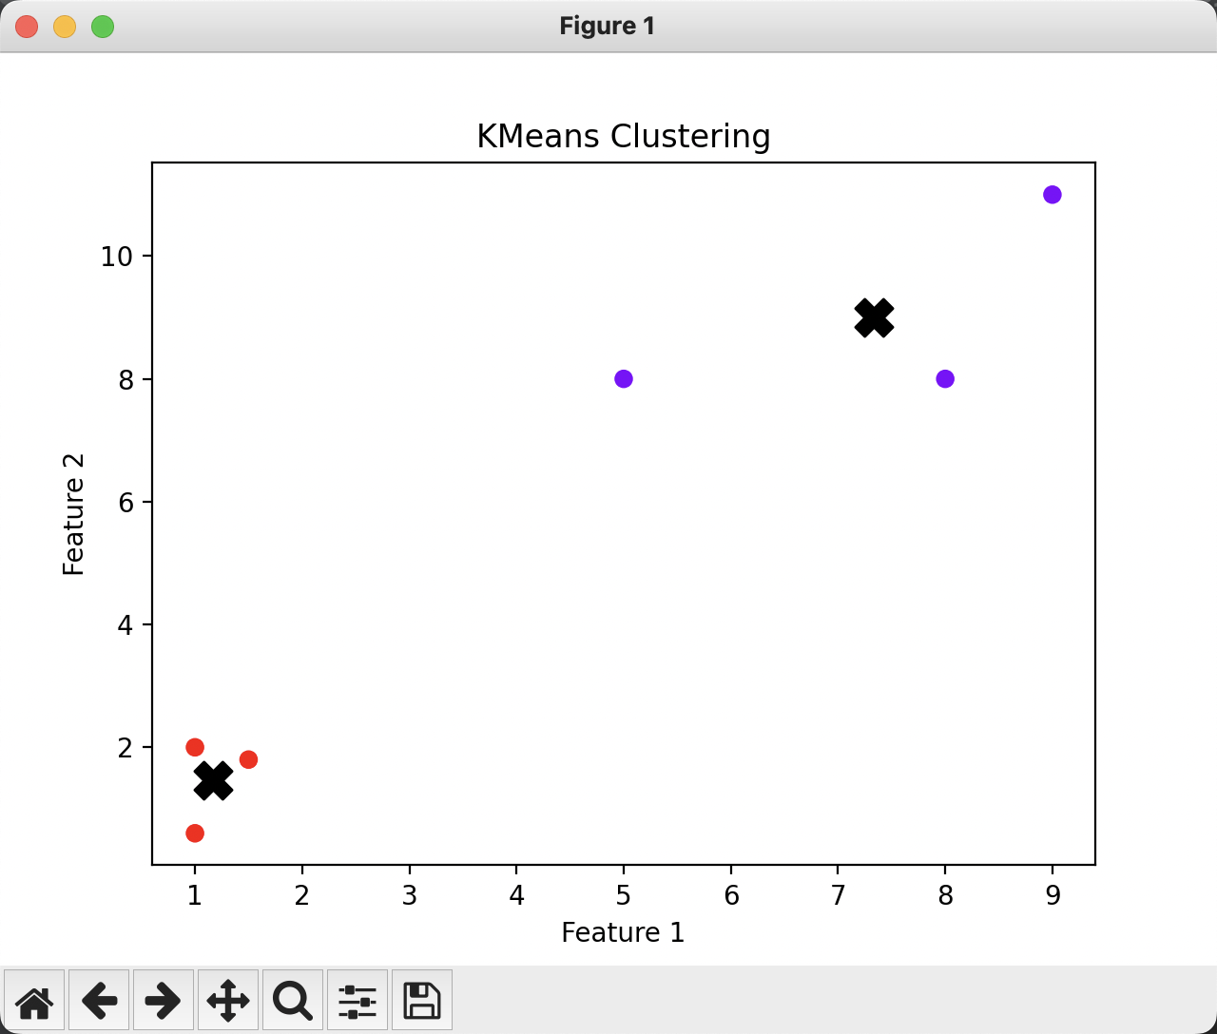
import numpy as np
from sklearn.cluster import KMeans
import matplotlib.pyplot as plt
# Generate sample data
np.random.seed(0)
X = np.array([[1, 2], [5, 8], [1.5, 1.8], [8, 8], [1, 0.6], [9, 11]])
# Define the number of clusters (K)
num_clusters = 2
# Initialize KMeans model
kmeans = KMeans(n_clusters=num_clusters)
# Fit the model to the data
kmeans.fit(X)
# Get cluster assignments and centroids
cluster_assignments = kmeans.labels_
centroids = kmeans.cluster_centers_
# Plot the data and cluster centroids
plt.scatter(X[:, 0], X[:, 1], c=cluster_assignments, cmap='rainbow')
plt.scatter(centroids[:, 0], centroids[:, 1], marker='X', s=200, c='black')
plt.xlabel('Feature 1')
plt.ylabel('Feature 2')
plt.title('KMeans Clustering')
plt.show()

Slide 19
import pandas as pd
from sklearn.feature_extraction.text import TfidfVectorizer
from sklearn.cluster import KMeans
from sklearn.model_selection import train_test_split
from sklearn.metrics import classification_report, confusion_matrix
from sklearn.metrics import silhouette_score, calinski_harabasz_score, davies_bouldin_score
from sklearn.preprocessing import LabelEncoder
import matplotlib.pyplot as plt
file_path = 'business_data.csv' df = pd.read_csv(file_path)
vectorizer = TfidfVectorizer(stop_words='english')
X = vectorizer.fit_transform(df['content'])
X_dense = X.toarray()
X_train, X_test, y_train, y_test = train_test_split(X_dense, df['category'], test_size=0.2, random_state=42)
kmeans = KMeans(n_clusters=2, random_state=42)
kmeans.fit(X_train)
y_train_clustered = kmeans.labels_
y_test_pred = kmeans.predict(X_test)
le = LabelEncoder()
y_test_encoded = le.fit_transform(y_test)
report = classification_report(y_test_encoded, y_test_pred, output_dict=True)
accuracy = report['accuracy']
recall = report['macro avg']['recall']
f1 = report['macro avg']['f1-score']
print(f"Accuracy: {accuracy:.4f}")
print(f"Recall: {recall:.4f}")
print(f"F1-Score: {f1:.4f}")
conf_matrix = confusion_matrix(y_test_encoded, y_test_pred)
print("Confusion Matrix:")
print(conf_matrix)
silhouette_avg = silhouette_score(X_train, y_train_clustered)
calinski_harabasz = calinski_harabasz_score(X_train, y_train_clustered)
davies_bouldin = davies_bouldin_score(X_train, y_train_clustered)
print(f"Silhouette Coefficient: {silhouette_avg:.4f}")
print(f"Calinski-Harabasz Index: {calinski_harabasz:.4f}")
print(f"Davies-Bouldin Index: {davies_bouldin:.4f}")
cluster_centers = kmeans.cluster_centers_
from sklearn.decomposition import PCA
pca = PCA(n_components=2)
X_train_2d = pca.fit_transform(X_train)
centers_2d = pca.transform(cluster_centers)
plt.figure(figsize=(8, 6))
plt.scatter(X_train_2d[:, 0], X_train_2d[:, 1], c=y_train_clustered, s=50, cmap='viridis', alpha=0.5)
plt.scatter(centers_2d[:, 0], centers_2d[:, 1], c='red', s=200, marker='x')
plt.title('KMeans Clustering with Cluster Centers')
plt.xlabel('PCA Component 1')
plt.ylabel('PCA Component 2')
plt.show()

Slide 20
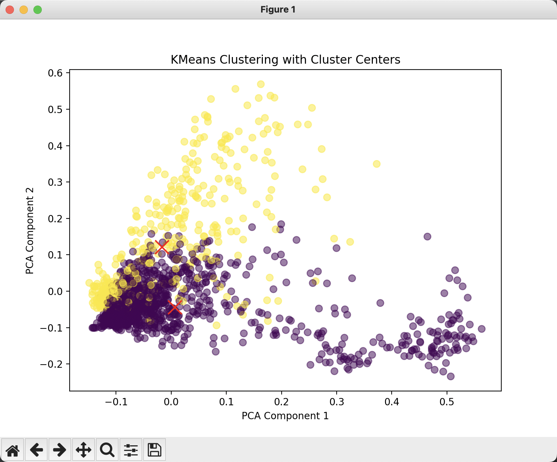
Accuracy: 0.6250
Recall: 0.6263
F1-Score: 0.5967
Confusion Matrix:
[[178 21]
[129 72]]
Silhouette Coefficient: 0.0083
Calinski-Harabasz Index: 17.4184
Davies-Bouldin Index: 8.4197

Slide 21
Comparison between various clustering algorithms
K-means and Hierarchical Clustering are classic clustering methods that are suitable for simple scenarios.
DBSCAN and Mean Shift are suitable for handling scenes with high noise or irregular cluster shapes.
GMM can be used for tasks that require soft clustering or have high requirements for cluster shape.
Spectral Clustering and Agglomerative Clustering perform well in data with complex geometric structures.

Slide 22
Mean Shift
Mean Shift is a density based clustering algorithm that does not require a pre-set number of clusters. It defines clusters by identifying high-density regions (patterns) in the dataset.
Applicable scenarios: Suitable for situations with unknown number of clusters and complex cluster shapes.
advantage:
There is no need to specify the number of clusters in advance.
Can adapt to non spherical clusters.
Disadvantages:
Sensitive to the scale of data, normalization of data is usually required.
The computational complexity is relatively high.
Application in NLP: Clustering can be used for text embedding representation, exploring different clustering structures when there is no clear number of clusters.

Slide 23
The mean shift algorithm explained step-by-step
1. Data preparation and preprocessing
The data needs to be appropriately preprocessed, especially when using distance metrics, which may require normalization or standardization of the data.
2. Select the bandwidth parameter (bandwidth)
Bandwidth is a key parameter that determines the search range, defining the range of the kernel function centered around each point. The larger the bandwidth, the larger the search area; The smaller the bandwidth, the more clusters there may be.
3. Kernel Density Estimation
Mean Shift uses kernel density estimation to identify density peaks around each data point. The commonly used kernel function is the Gaussian kernel function, which calculates the weighted average position of each data point to its neighboring data points.

Slide 24
The mean shift algorithm explained step-by-step
4. Mean Shift
Calculate the weighted average of all neighboring points within a given bandwidth range for each point, and move the point to the position of the average.
Repeat this process continuously until all points converge at the local density peak.
5. Determination of cluster center
After all data points converge, data with similar convergence points will be grouped into the same cluster, and the mean position of these points is the center of the cluster.
6. Cluster allocation
Assign cluster labels to each point, where clusters are determined by the final positions of points with similar densities.
7. Evaluate clustering results
The evaluation of clustering results can be measured using standard clustering evaluation indicators such as silhouette coefficient, Calinski Harabasz index, Davies Bouldin index, etc.

Slide 25
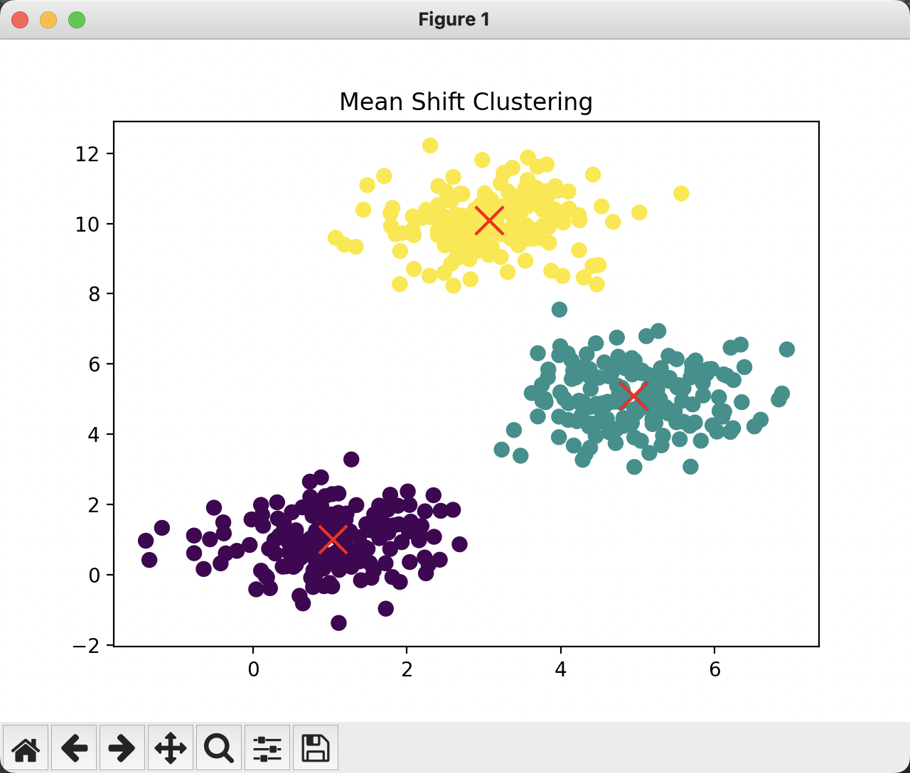
import numpy as np
import pandas as pd
from sklearn.cluster import MeanShift, estimate_bandwidth
from sklearn.datasets import make_blobs
from sklearn.metrics import silhouette_score, calinski_harabasz_score, davies_bouldin_score
import matplotlib.pyplot as plt
centers = [[1, 1], [5, 5], [3, 10]]
X, _ = make_blobs(n_samples=500, centers=centers, cluster_std=0.8)
bandwidth = estimate_bandwidth(X, quantile=0.2, n_samples=500)
mean_shift = MeanShift(bandwidth=bandwidth, bin_seeding=True)
mean_shift.fit(X)
labels = mean_shift.labels_
cluster_centers = mean_shift.cluster_centers_
n_clusters = len(np.unique(labels))
print(f'Estimated number of clusters: {n_clusters}')
silhouette_avg = silhouette_score(X, labels)
calinski_harabasz = calinski_harabasz_score(X, labels)
davies_bouldin = davies_bouldin_score(X, labels)
print(f"Silhouette Coefficient: {silhouette_avg:.4f}")
print(f"Calinski-Harabasz Index: {calinski_harabasz:.4f}")
print(f"Davies-Bouldin Index: {davies_bouldin:.4f}")
plt.scatter(X[:, 0], X[:, 1], c=labels, s=50, cmap='viridis')
plt.scatter(cluster_centers[:, 0], cluster_centers[:, 1], c='red', s=200, marker='x')
plt.title('Mean Shift Clustering')
plt.show()
Estimated number of clusters: 3
Silhouette Coefficient: 0.7359
Calinski-Harabasz Index: 3323.0318
Davies-Bouldin Index: 0.3636

Slide 26
if n_clusters > 1:
report = classification_report(df['category_encoded'], df['cluster'], output_dict=True)
accuracy = report['accuracy']
recall = report['macro avg']['recall']
f1 = report['macro avg']['f1-score']
print(f"Accuracy: {accuracy:.4f}")
print(f"Recall: {recall:.4f}")
print(f"F1-Score: {f1:.4f}")
conf_matrix = confusion_matrix(df['category_encoded'], df['cluster'])
print("Confusion Matrix:")
print(conf_matrix)
silhouette_avg = silhouette_score(X_array, df['cluster'])
calinski_harabasz = calinski_harabasz_score(X_array, df['cluster'])
davies_bouldin = davies_bouldin_score(X_array, df['cluster'])
print(f"Silhouette Coefficient: {silhouette_avg:.4f}")
print(f"Calinski-Harabasz Index: {calinski_harabasz:.4f}")
print(f"Davies-Bouldin Index: {davies_bouldin:.4f}")
cluster_centers = mean_shift.cluster_centers_
plt.scatter(X_array[:, 0], X_array[:, 1], c=df['cluster'], s=50, cmap='viridis')
plt.scatter(cluster_centers[:, 0], cluster_centers[:, 1], c='red', s=200, marker='x')
plt.title('Mean Shift Clustering')
plt.show()
else:
print("Only one cluster found, evaluation metrics cannot be calculated. Consider adjusting the bandwidth or quantile parameters.")
import pandas as pd
from sklearn.feature_extraction.text import TfidfVectorizer
from sklearn.cluster import MeanShift, estimate_bandwidth
from sklearn.metrics import classification_report, confusion_matrix
from sklearn.metrics import silhouette_score, calinski_harabasz_score, davies_bouldin_score
from sklearn.preprocessing import LabelEncoder
import matplotlib.pyplot as plt
df = pd.read_csv(file_path)
vectorizer = TfidfVectorizer(stop_words='english')
X = vectorizer.fit_transform(df['content'])
X_array = X.toarray()
mean_shift = MeanShift(bandwidth=0.6, bin_seeding=True)
mean_shift.fit(X_array)
df['cluster'] = mean_shift.labels_
le = LabelEncoder()
df['category_encoded'] = le.fit_transform(df['category'])
n_clusters = len(set(mean_shift.labels_))
print(f"Estimated number of clusters: {n_clusters}")

Slide 27
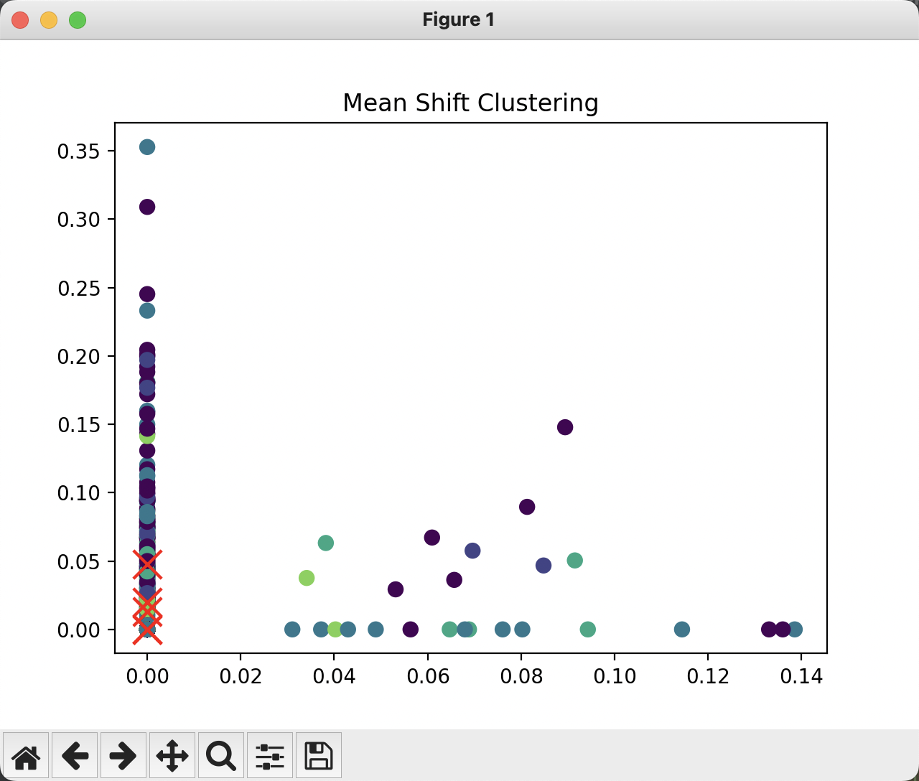
Accuracy: 0.1795
Recall: 0.0599
F1-Score: 0.0796
Confusion Matrix:
[[290 67 313 189 124 16]
[338 69 270 188 130 6]
[ 0 0 0 0 0 0]
[ 0 0 0 0 0 0]
[ 0 0 0 0 0 0]
[ 0 0 0 0 0 0]]
Silhouette Coefficient: 0.0055
Calinski-Harabasz Index: 6.8706
Davies-Bouldin Index: 10.6080

Slide 28
Exercises 1
Please use the k-means algorithm to cluster the dataset you prepared in the first week. The target category number can be set as the default category number of the current dataset or other number.
Consider whether the category cluster obtained by the clustering algorithm consistent is the original label system?

Slide 29
Exercises 2
Please use the mean shift algorithm to cluster 80% of the samples in the dataset you prepared in the first week. By various preprocessing and adjusting bandwidth parameters, the final number of categories need be made consistent with the original number of categories.
Use clustering models to predict categories for the remaining 20% of sample data. Consider whether the clustering model performs better than the classification model when the number of categories is same?

Slide 30

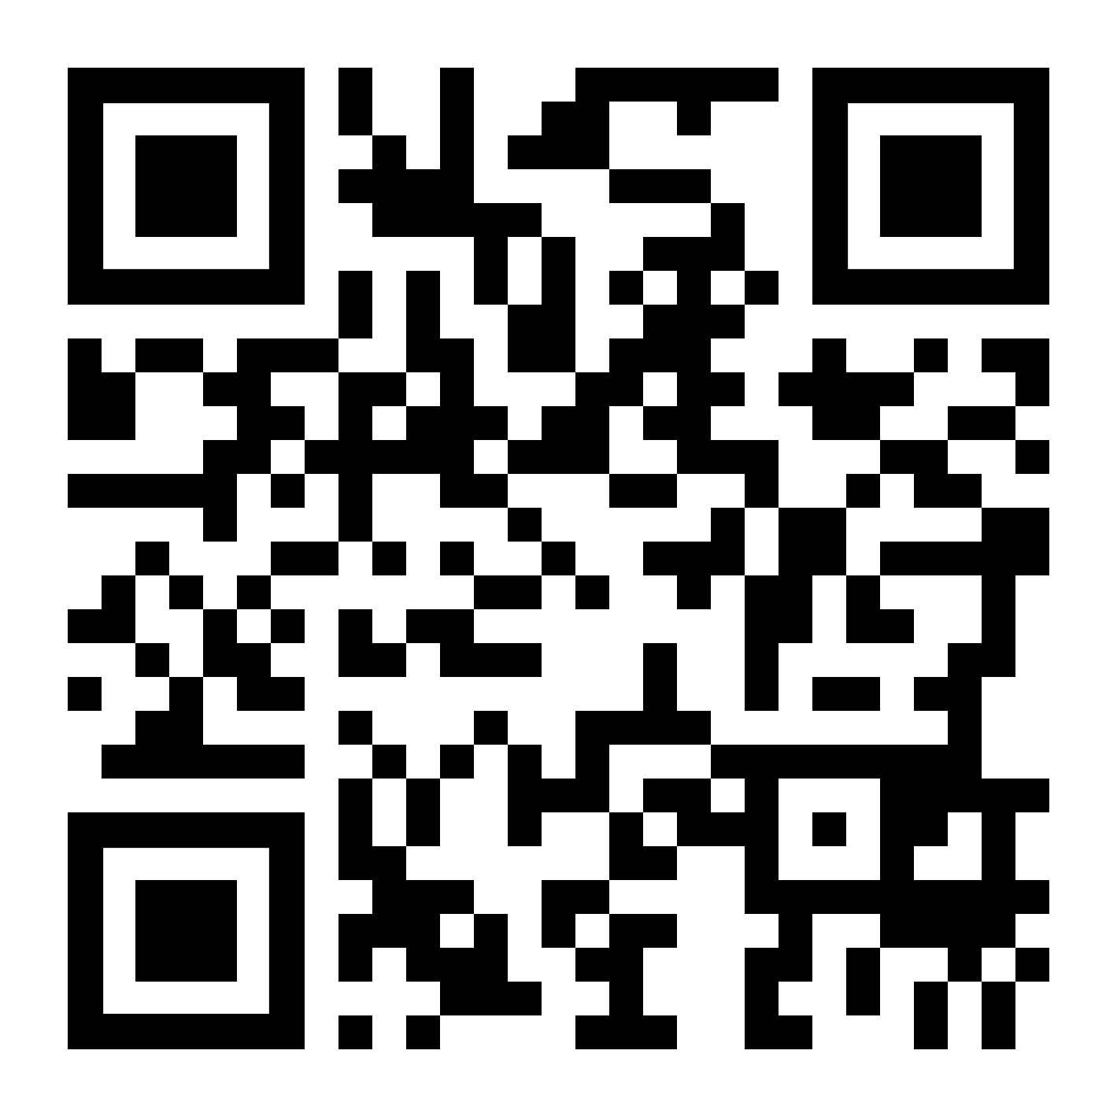

THANK YOU
Visit us
FOLLOW us
www.xjtlu.edu.cn
Notes:
Title: Uppercase, Calibri size 60, XJTLU Navy

